Slide 1
Socially Relevant Project
Happy
Coding!!!
BY
(B.Tech IT – III year)
Ajitaa Jagannathan – 2015115004
Saravanan Rajendran – 2015115048
Sshreya .K.Y - 2015115115

Slide 2

Project scope

Slide 3
Usage
Novices to Experts in programming
It reduces the manual effort
Solutions are available in your editor

Slide 4
Usage
Novices to Experts in programming
It reduces the manual effort
Solutions are available in your editor

Slide 5
Module Description
The plugin “Happy coding”
It uses Sublime API to display
Web scraping

Slide 6
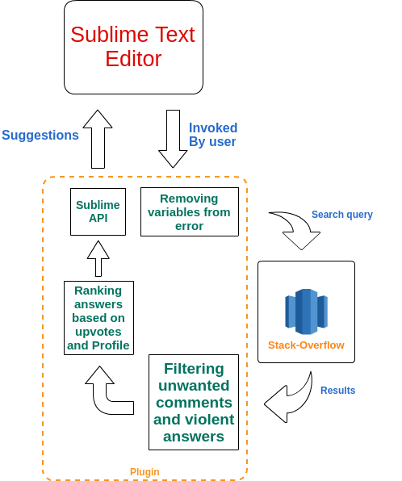
Architecture Diagram

Slide 7

Socially Relevant Project

